Slide 1



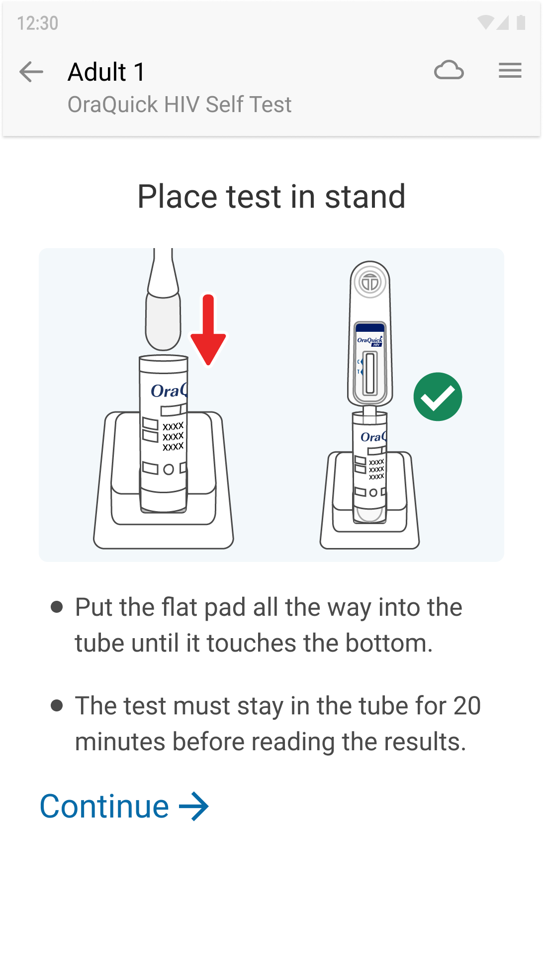
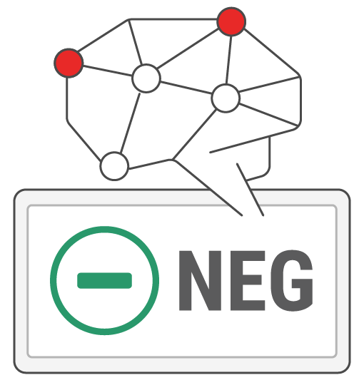
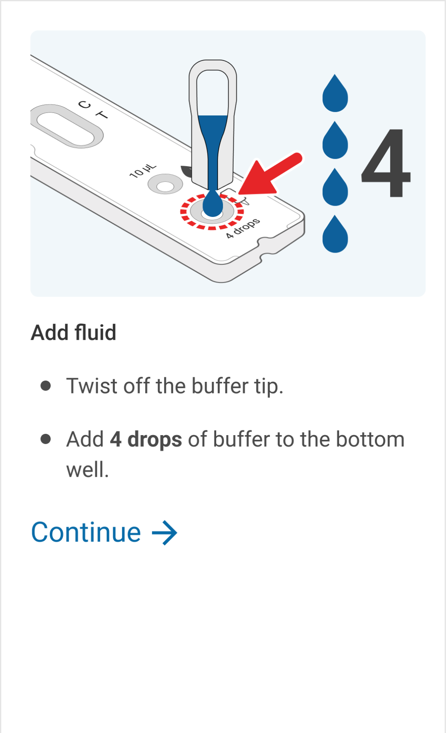












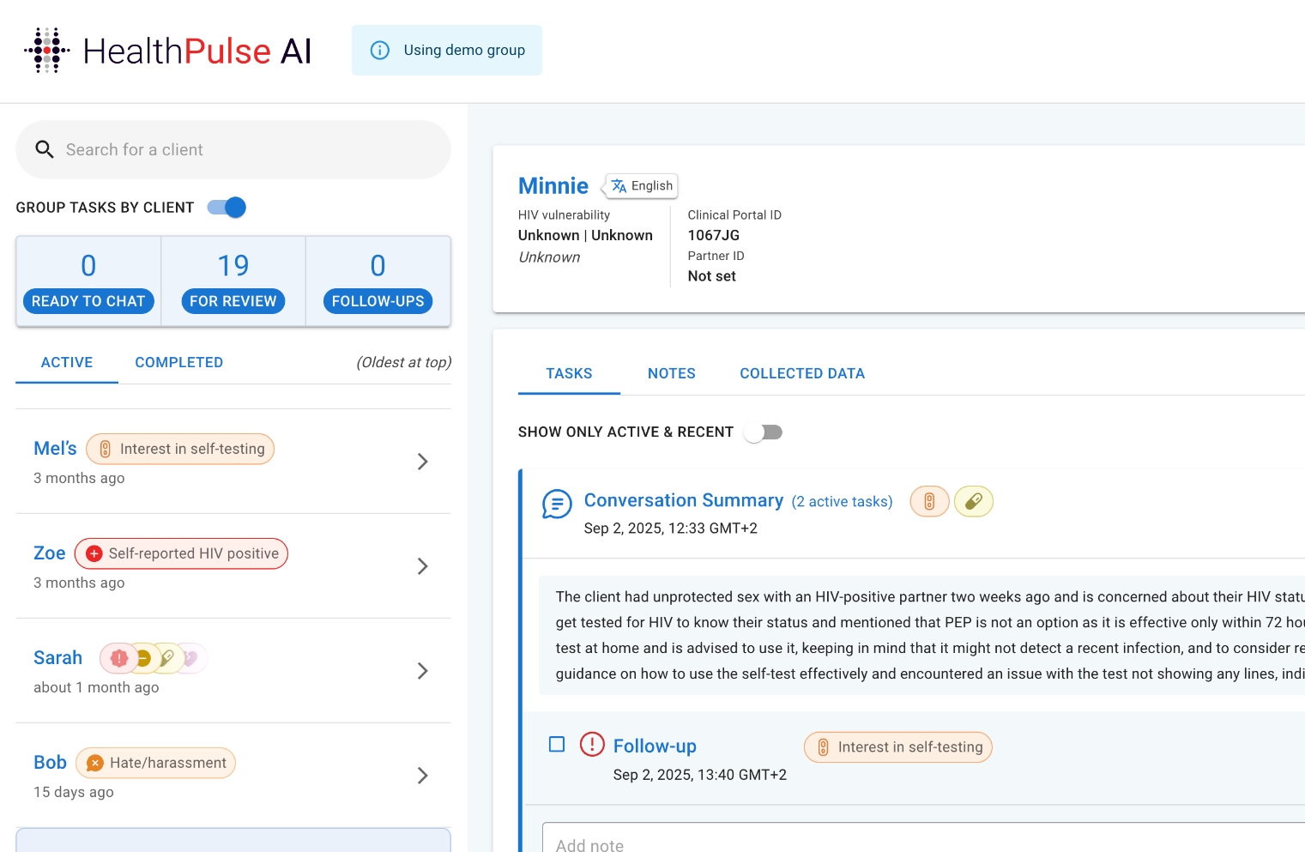

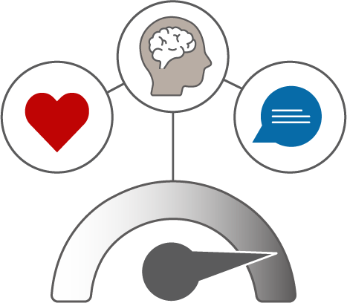



Self-care from Anywhere: An interoperable platform with
Multimodal AI for Primary Health & Lifestyle support
Empathetic Conversation
Engaging, stigma-free lifestyle conversations & connection to care
Guided Testing
Accessible digital instructions & result support
for quality assurance
I’m sorry PrEP makes you sick, want to talk about other options?
Informed Conversations
AI Companion via
Omnichannel LM Service
Quality Test Result Capture
Computer Vision
& IFU services
Ya someone said a shot’s coming?
Yes! A 6-month shot will be available in January, can you share a bit more info so we can see if its right for you?
Hybrid Monitoring & Evaluation for safety
Clinician Efficiencies
Web portal highlights anomalies, chat summaries, & enables client connections
Personalized Experiences
Nudges based on behaviors, attitudes, and needs
Tailored Care Path
Predictive Analytics
Client Prioritization & Alerts
Machine Learning
Hey sis, excited for the braai just now?
HIV vulnerability score
HIGH | Confident
LEN candidate: HIGH
How was your clinic visit, did you get the shot?
Confidential & Proprietary
Notes:
This is why we created Self-Care from anywhere - to enable [click]
24/7 access to information and empathetic counseling via an AI companion, powered by Generative AI and delivered on a platform they already use and trust: WhatsApp; [click]
with guided self- testing and computer vision validated results, [click]
personalized risk stratification and nudges driven by predictive analytics, and finally, [click]
A seamless connection to care from nurses supported by AI-driven signals.
Through this solution, we provide a safe, judgment-free space to share, learn, and receive support. As trust grows, people begin to voice the real questions—the ones that are the greatest barriers to changing behavior.
And because safety is non-negotiable in health, everything is safeguarded by a hybrid monitoring and evaluation framework—combining automated harm flagging with human-in-the-loop verification.

Slide 2
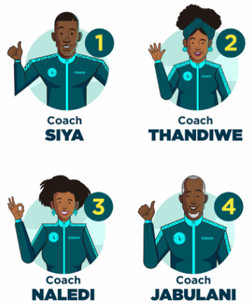
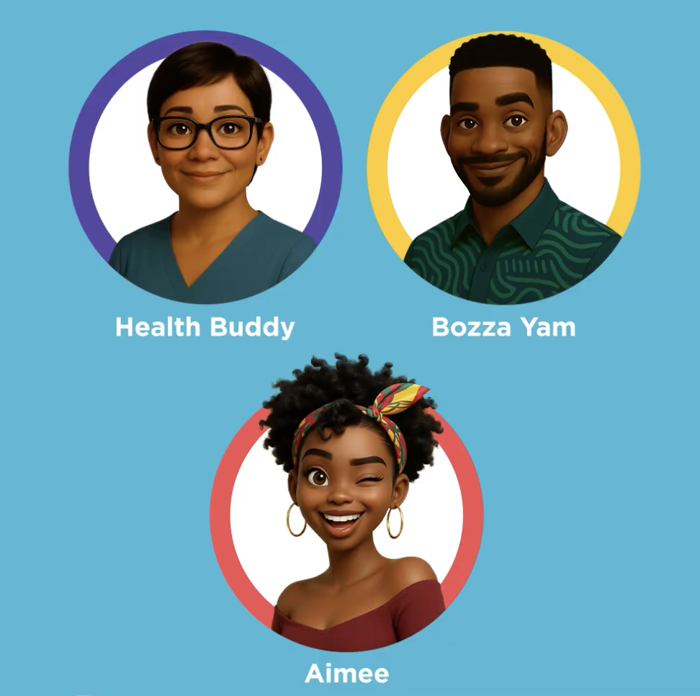

Why does co-design with communities, care orgs, & MoH matter?
Launched in 2025, after 9 months live:
nearly 400,000 user inquiries from real people, in the real-world, not in a lab
Over 35,000 real users across SA & Zimbabwe, >50% deeply engaging
Approx 50% of users linking and accessing SRH & HIV services (program goal)
No above the line marketing
“I trust my besties, I want a confidant always there. I don’t want to use my real name, a fake name makes me feel more comfortable.” AGYWs SA
“I trust people like me - who can normalise what I’m going through… don’t want to be hunted down by the govt.” - Adult PLHIVs SA
“Trust builds over time, don’t get too familiar too fast”
ABYMs SA
Validation for Scale-up
any regulatory, policy, health system integration pilots, etc
Efficiency investments & Evaluation
AI, tech, processes
Impact Evaluation
Implementation research evaluating feasibility, acceptability
User Evaluation: Product Usability
Hybrid M&E: Automated & Human-in-the-loop AI monitoring
Product, Engagement, Usage monitoring
AI & Technology Evaluation
Solution Development / Customisation
Co-design with users, providers, MoH, stakeholders
Problem, R&D, Prototype
Notes:
While many insights came from our co-design sessions, we focused on trust as our core priority- how do you build trust, what signals you can trust someone or something, what breaks trust? With this as our focus, we honed in on what really matters in a new relationship- with a person, with a digital product, or an AI companion that you go to for advice and information

Slide 3


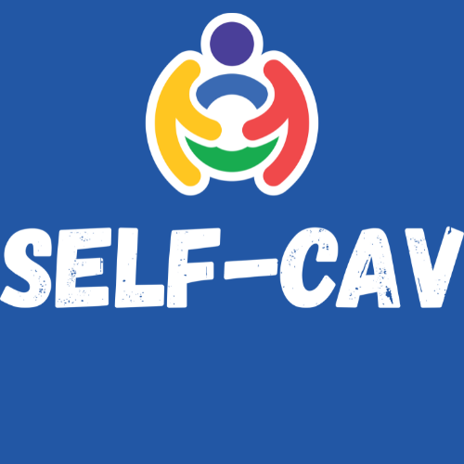
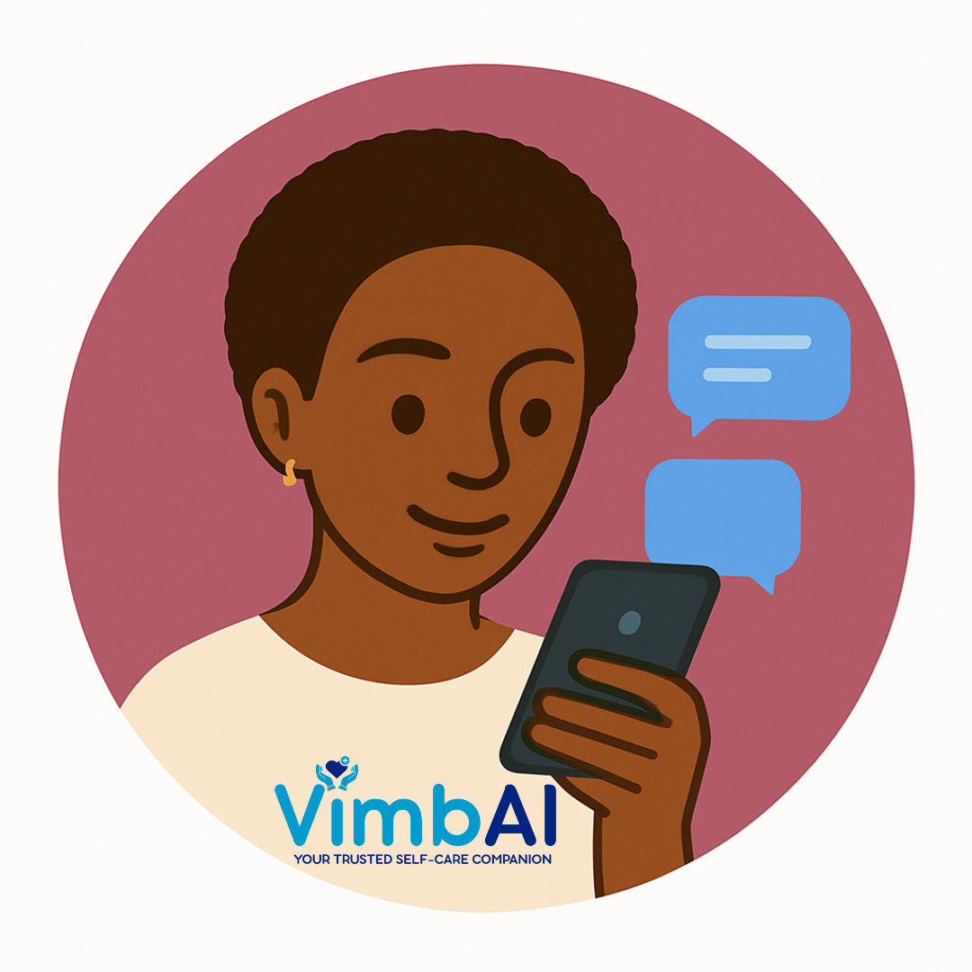





















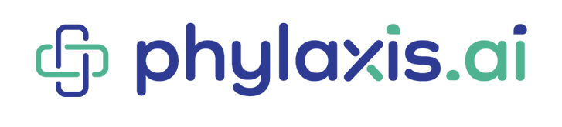
Self-Care from Anywhere Platform for Lifestyle & Primary Health
Adaptable, multilingual, locally contextual tools with customisable
Nudging for population and intervention specific goals
Self-Cav: Support for sexual health, HIV prevention, contraception, and mental health for Youth in SA through the NDoH https://bwisehealth.com
VimbAI for HIV Prevention: FSW, EoSW in Zimbabwe
Study w/CESHHAR
Aimee for HIV Prevention: AGYW in South Africa Study w/Shout-it-Now
March-Nov 2025
Coach Mpilo: for Adults & People Living with HIV, support for treatment adherence, TB & anxiety, depression, alcohol screening Study w/PSI
Validation for Scale-up
any regulatory, policy, health system integration pilots, etc
Efficiency investments & Evaluation
AI, tech, processes
Impact Evaluation
Implementation research evaluating feasibility, acceptability
User Evaluation: Product Usability
Hybrid M&E: Automated & Human-in-the-loop AI monitoring
Product, Engagement, Usage monitoring
AI & Technology Evaluation
Solution Development / Customisation
Co-design with users, providers, MoH, stakeholders
Problem, R&D, Prototype
Notes:
We began this journey nearly two years ago through an inclusive co-design process — bringing together community voices, policy leaders, and service providers to shape both the technology and the experience. We held workshops, focus groups, in-depth interviews, and hands-on prototype sessions with potential clients to ensure the solution reflected their needs and realities.
Since launch, we’ve maintained a real-time feedback loop — learning from user behavior and continuously evolving the platform.
[CLICK] To date, through partnerships with ministries of health and the organizations seen here, we’ve launched 4 primary care and lifestyle AI companions for HIV and TB support in South Africa and Zimbabwe.
Today we’ll be mainly be sharing insights from Aimee, a study which was focused on AGYW.

Slide 4
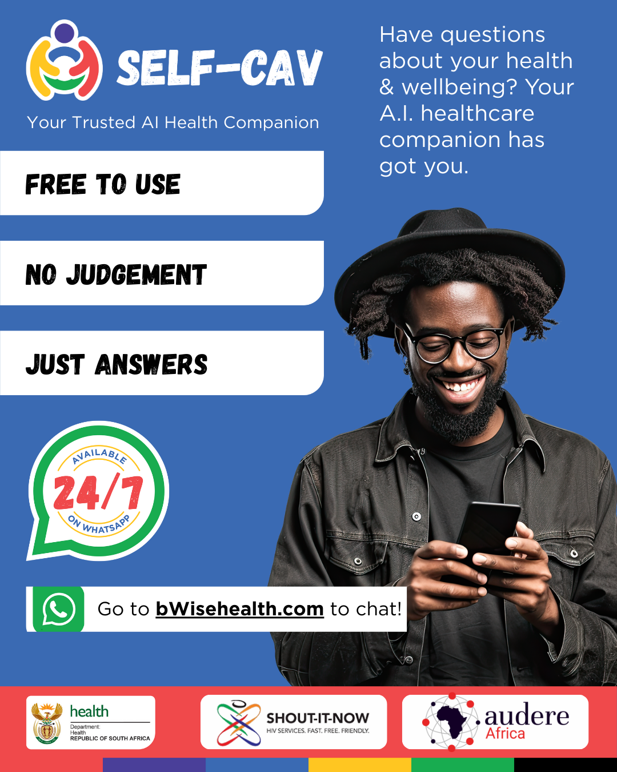
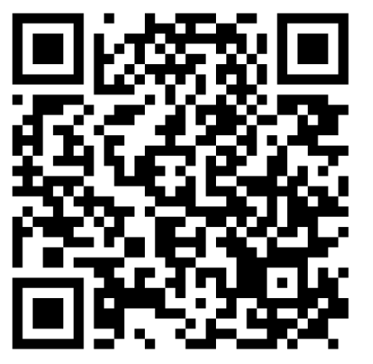
Key Learnings
Lifestyle counseling, vs. single health condition builds trust & meets client needs
Unlike traditional chatbots, companions built on the Self-Care platform provide answers to any question, building trust and escalating to clinicians for diagnosis & care plans.
AI Companions act as triage support for clinical staff
30% of AI chats take place outside of clinic hours, with GBV, self-harm, relationships (barriers to care) discussed significantly more often with AI than clinicians.
AI supports info seeking before & after care uptake
Half got counseling before HIV testing, with nearly 20% engaging in emotional support discussions with AI. BUT >50% got support from AI after testing and receiving results, and/or taking up contraception, PrEP, ART, or other STI treatment.
Notes:
Now many of you may be overwhelmed by all the different AI solutions and tools available. But to Prof Darelle’s presentation, there has been a lack of AI solutions developed and localised for the African context.
So as part of our Self-Care from Anywhere program, we developed Self-Cav for youth in South Africa to shape the kind of engagement we believe leads to trust, reflection, and care-seeking of individuals to improve health and well-being.
Self-Cav is a Whatsapp AI companion that anyone can engage with to access trusted information on everything from relationships, to STIs, to HIV prevention - all on their own timeline. It is currently available via the B-Wise website which is a South African digital health platform developed by the National Department of Health (NDoH) {{to provide youth-friendly, non-judgmental, and accessible health information and services to young people aged 10–24}}
So what goes into developing a AI companion, what does it look like in practice, why is it valuable for youth and how can it help you?

